Slide 1



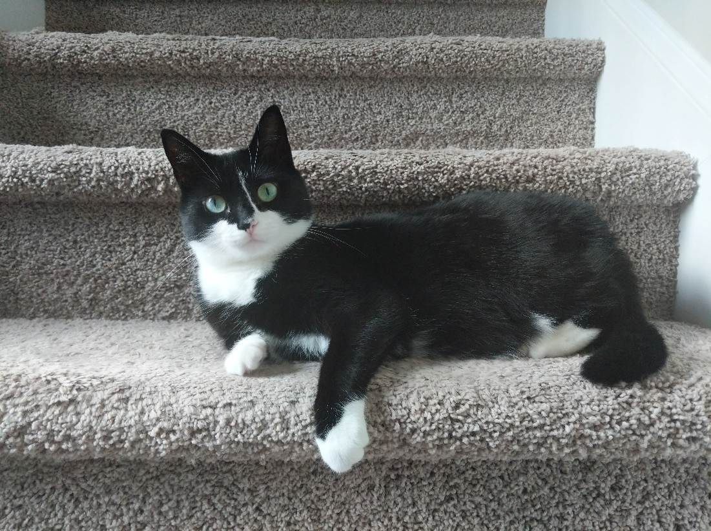
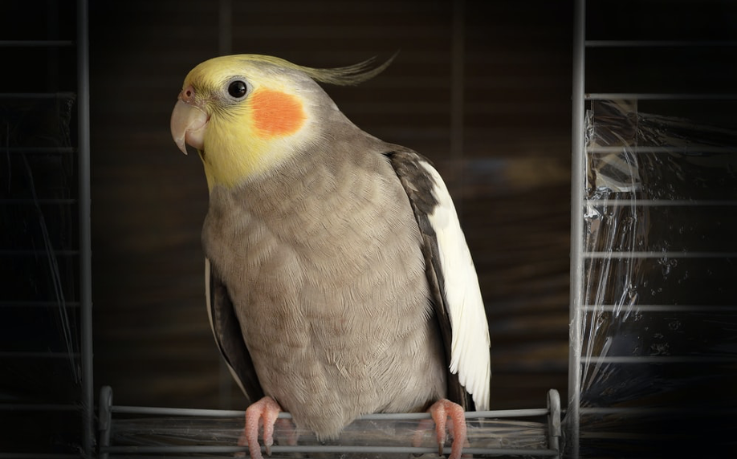
Evidence-Based Pet Care Advice for Every Pet Lover.
Home
Dogs
Cats
Birds
Contact Us
Our Mission
Guides
Please schedule a consultation with our Pexperts today!
Pets are nature's gift to humanity. It has been scientifically proven that opening our homes and hearts to a pet increases our longevity and improves our overall quality of life as well as the lives of our pets. Paradigm Pet Professional’s mission is to offer resources to help you care for your furry, scaly, feathery, and slimy loved ones. Our pet experts—or "Pexperts"—have worked with pet owners and professionals for twelve years. They offer one-on-one consultations with current and prospective pet owners and group presentations designed for veterinary, pet shelter, and pet breeding professionals.
Learn More
Schedule a Consultation
Expert advice for your dog
Expert advice for your cat
Expert advice for your bird
About Us
Resources
Request a Consultation!

Slide 2
Expert Advice for Your Dog.
Home
Dogs
Cats
Birds
Contact Us
Our Mission
Guides
Diet & Exercise: Throughout dogs' lifespans, they should generally be fed fewer meals as they mature. Puppies should be nursed for the first two months and then introduced to three meals daily when they are about three to six months old. Their food intake should be reduced to two meals per day when they are six months to one year old and finally reduced to one meal after they reach one year old. A dog's typical body mass is composed of somewhere between 60 and 70 percent water. The ASPCA says just a 10 percent decrease in body water can cause illness, and a 15 percent loss can cause death, so ensure you keep your pooch hydrated!
Grooming & Handling: Keeping your furry family member clean is important to its health. Be sure to brush frequently to reduce shedding and prevent matted and tangled fur. Check for insects such as ticks and fleas, especially after visiting heavily wooded areas. Bathing is important to your dog's health and can also be an exercise, depending on how strong-willed the dog is. Rinse all the soap out, as any residual soap can result in a rash. Be sure the soap is formulated for your puppy or dog since harsh soaps can cause allergic reactions.
Vaccinations & Medications: You should always consult with your veterinarian, but there is a core set of vaccines that are typically recommended. Vaccines that reduce exposure to things such as hepatitis, rabies, and parvovirus. Your vet may determine others depending on the dog's environment.
Schedule a Consultation
About Us
Resources
Request a Consultation!

Slide 3
Expert Advice for Your Cat.
Home
Dogs
Cats
Birds
Contact Us
Our Mission
Guides
Zero to Four Weeks: It is important the queen (a term commonly used for a female cat that is either pregnant or nursing) directly nurse her young if possible. Monitor your kitten's growth closely to ensure its growth rate progresses steadily. If any kitten is not growing sufficiently, a caretaker might need to feed the kitten directly, either with a bottle or a feeding tube.
Four Weeks to One Year: Kittens can be introduced to soft, wet kitten food around three to four weeks after birth. According to the ASPCA, kittens at this age should eat half to one cup of dry kitten food or six to nine ounces of wet kitten food per day. If your kitten has difficulties eating hard food, a small amount of water can be added to soften the food.
One Year to Seven Years: This age is when kittens reach the cat stage and do not need as many nutrients. At this age, their activity level decreases, and so does their metabolism. It is not recommended to leave food out for the cats all day. Instead, provide food several times so they eat meals rather than snacking throughout the day.
Seven Years and More: Cats at this age should eat less fats and calories and more quality proteins. This means when you are purchasing packaged foods for your cat, look for food that states a particular protein (such as "salmon") and not just a category (such as fish).
Schedule a Consultation
About Us
Resources
Request a Consultation!

Slide 4
Expert Advice for Your Bird.
Home
Dogs
Cats
Birds
Contact Us
Our Mission
Guides
Relational Needs of Birds: Birds are intriguing creatures, ranging from birds as small as a Cuban bee hummingbird (about two inches long and slightly over 1/20 of an ounce) to an ostrich. While most birds fly, some don't. Birds are amazing, and each breed is unique in its own way, particularly regarding their relational needs and well-being.
Signs of Depression in Birds: Unfortunately, birds can experience sadness and depression just like humans. A number of root causes may be responsible for your bird's depression, such as an illness (either physical or mental), losing its companion, or increasingly becoming bored. Some signs to help identify if your bird is experiencing depression may include reduced appetite, becoming increasingly irritable, aggressive behavior, and songs having a different, more solemn tone.
Tips for Bird Care: Be sure to tell your veterinarian if you see signs of any of these symptoms. Just like many illnesses, identifying and treating the symptoms earlier may drastically increase the lifespan of your birdie.
Schedule a Consultation
About Us
Resources
Request a Consultation!

Slide 5
Get n Touch With Our Pexperts
Home
Dogs
Cats
Birds
Contact Us
Our Mission
Guides
Name:
Phone Number:
Email Address:
Time Zone:
Pet’s Name:
Pet Type:
Pet’s Age:
Additional Notes (optional):
Submit
About Us
Resources
Request a Consultation!

Slide 6
About Us – Paradigm Pet Professionals
Home
Dogs
Cats
Birds
Contact Us
Our Mission
Guides
Evidence-Based Pet Care Advice for Every Pet Lover
Paradigm Pet Professionals is dedicated to providing evidence-based pet care advice to help you care for your furry, scaly, feathery, and slimy loved ones. With over 12 years of experience, our team of certified pet experts—or 'Pexperts'—are here to support you every step of the way. Whether you're a first-time pet owner or a seasoned pro, we offer personalized consultations and resources to ensure the lifelong health and wellness of your pets.” Our Mission: Our mission is to empower pet owners with the knowledge and tools they need to provide the best care for their pets. We believe that every pet deserves a happy, healthy life, and we're here to make that possible. Our Team: Our team of Pexperts includes certified pet health and nutrition specialists with years of experience working with pet owners and professionals alike. We are passionate about pets and committed to providing the highest level of care and support.
Interested in learning more about our services or scheduling a consultation? Contact us today!
Request a Consultation
About Us
Resources
Request a Consultation!
About Us

Slide 7
Resources – Paradigm Pet Professionals
Home
Dogs
Cats
Birds
Contact Us
Our Mission
Guides
Helpful Guides and Links for Pet Owners
We’ve compiled a list of resources to help you care for your pets, from adoption guides to pet care tips. Whether you're a new pet owner or looking for advanced advice, these resources are here to support you. Adoption Resources: Looking to adopt a new pet? Check out these organizations to find your perfect companion:
General Pet Resources: https://bestfriends.org/pet-care-resources/issues/pet-adoption-resources
ASPCA: https://www.aspca.org/
Pet Care Guides: Explore our collection of pet care guides to ensure your pet stays healthy and happy: Guinea Pig Care: https://www.animalhumanesociety.org/adoption/guinea-pig-care
Mouse Care: https://www.bluecross.org.uk/pet-advice/caring-your-mouse Need personalized advice? Schedule a consultation with one of our Pexperts today!
Request a Consultation
About Us
Resources
Request a Consultation!

